Slide 1
StegAnalysis 1400/2
Instructor:
Behnoud shafizadeh

Slide 2
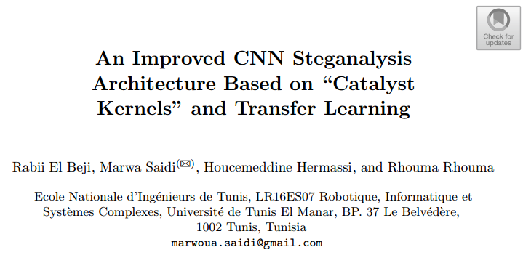
Related paper in 2018

Slide 3
Abstract of paper (summarization)
Main contributions:
Using CNN for steganalysis
Simple model and small image dataset rather than complex models
The robustness of method related to High Pass Filter (HPF) to extract the residual noise beside transfer learning
Using batch normalization for increasing convergence speed in training phase
Three different steganographic datasets WOW, S-UNIWARD, and HUGO are used for evaluation
Classification accuracy rate 96%

Slide 4
introduction
Steganography is the art of hiding secret data in different area (video, sound, image,…)
various steganographic methods are:
Spatial domain : embedding within the LSBs (Pixels)
frequency domain : modifying the DCT coefficients instead of manipulating pixels values
some of adaptive (to the texture of images) approaches in the spatial domain : HUGO, WOW, and S-UNIWARD. (more undetectable secret data)
Steganalysis aims mainly to detect the very existence of potential secret messages
enormous evolution of hardware (GPUs) lead to enter different approachs such as SVM,EC,CONV NET in steganalysis

Slide 5
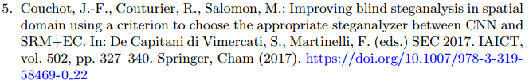

Literature review
some of basic papers which are originated from Qian et al basis on CNN method are:

Slide 6
their contributions
To accelerate the convergence of CNN model for a steganographic in the JPEG domain, Chen et al. proposed four specific filters fixed in the first layer of their CNN architecture. These filters act as “catalyst kernels” that accelerate network convergence .
HPF Kernels + transfer learning
Main contribution

Slide 7
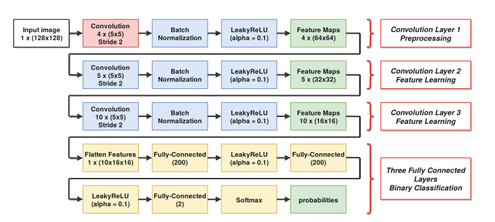
Model description
Proposed Cnn model=3 (conv layers for preprocessing and feature learning) + 3 (dense layers for the binary classification).

Slide 8
Preprocessing layer
There have 4 preprocessing filters :
The first 5 × 5 size FKV filter : It conceal the correlated components while largely preserving the high frequencies of the treated signal.
FP filter : a high-pass filter selected to complement FKV
FH filter : horizontal gabor filter
FV filter : vertical gabor filter
These two filters are added within the pre-treatment step due the fact that FKV and FP are not directional. Basically, The catalyst kernels are beneficial in terms of increasing the SNR between the cover and the stego objects. They also act as regularizers to reduce the feature space dimensionality, thus helping facilitating the convergence of the network.

Slide 9
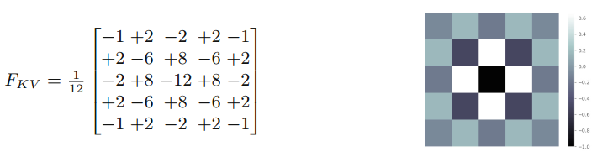
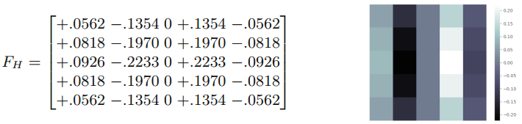
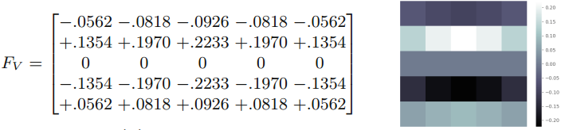
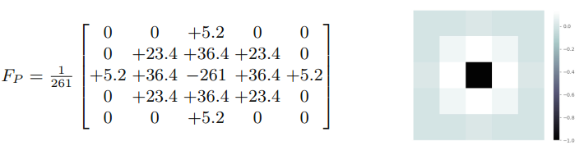
5*5 filters for preprocessing

Slide 10
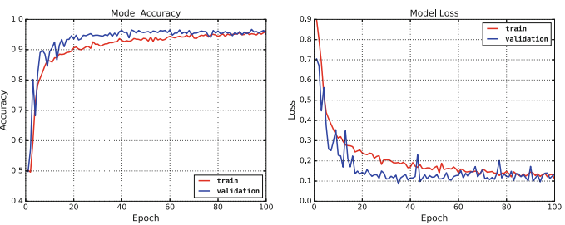
Train from scratch on WOW
using wow algorithm steganographic dataset with rate (1bpp) highest payload
100 epochs
using RMS-Prop optimizer with binary cross Antropy loss function
achieving 96% accuracy

Slide 11
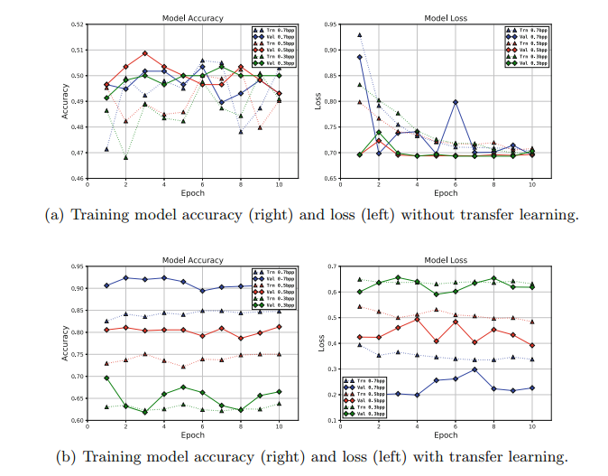
Using transfer learning
it is impossible to ensure a convergence with our model using learning from scratch with low payload such as 0.7 bpp, 0.5 bpp or 0.3 bpp. Thus, we choose to exploit the best weights of convolutional layers obtained by training on high payloads first, then we adjust these weights as an initialization to the training of our new dataset with lower payloads. This concept is called transfer learning and it is widely used in deep learning to minimize training time and ensure a rapid convergence of networks towards the best aaccuracy.

Slide 12
Experimental Setup
Dataset BOSSbase v1.01 : which contain 10,000 cover images of size 512 × 512.
train and test : We just take the first 2400 images and resized to 128×128. Out of the 2400 pairs of images, 400 pairs (cover,stego) were split and left for testing to verify the performance of the proposed model so we have 1700 train ,300 validation ,400 test
using mini batch of 16 (8 cover/stego pairs)
the code is implemented on Keras API
Using GOOGLE COLAB for training/testing

Slide 13
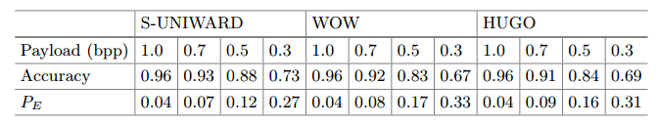
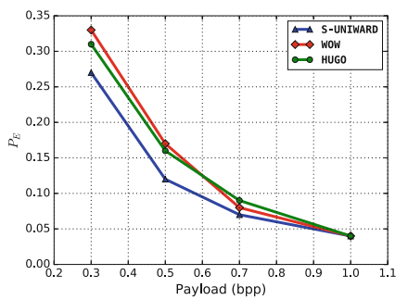
Model performance
using 3 different steganographic dataset for train/test with different bpp rate (0.3,0.5,0.7,1)
We notice that in following figure, our method shows an efficient performance, in terms of classification, against S-UNIWARD algorithm for small payloads. The curve of WOW has the weakest detection almost for all payloads comparing to other approaches’ curves.

Slide 14
Thanks for your consideration.

